Slide 1

Predicting Taxi Cancellation
By Alexey Aulov

Slide 2
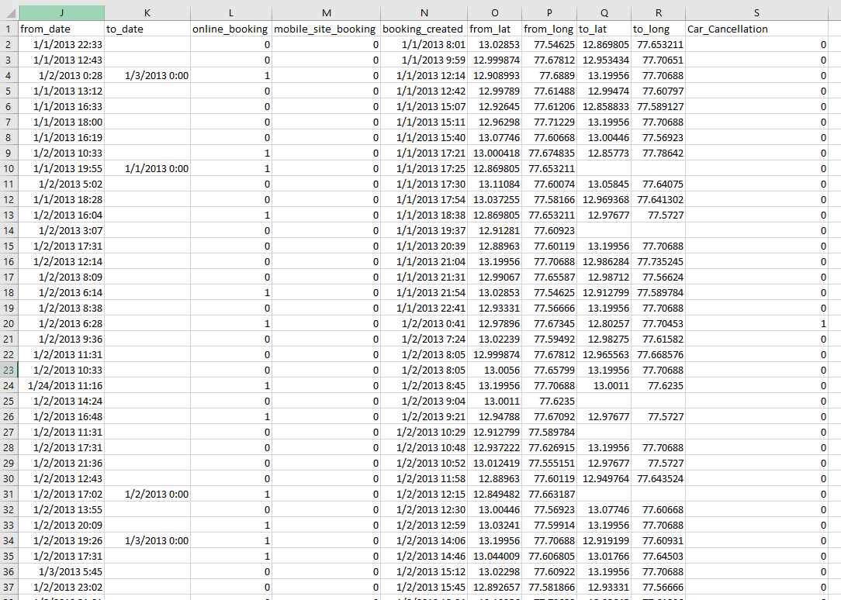
Data Set Used(relevant attributes only)

Slide 3
Vision and Objectives
Vision:
•The goal of this project is to understand if there would be a taxi cancellation using supervised learning with different models.
Objectives:
• Make 4 predictive models (KNN, Naïve Bases, Logistic Regression)
• Compare and present one that is more suitable for predicting the taxi cancellation
•Predictive model should show the relationship between the dependent variable and independent variable.

Slide 4
Independent, Dependent Variable, and Model Chosen
Independent | Dependent
From_Date | Car_Cancellation
To_Date
Online_Booking
Mobile_Site_Booking
Booking_Created
From Lat
From Long
To_Lat
To_Long
All Models Split | Row Amount | Replacing Missing Value with
70/30 | 10,001 | 0
Main Model and Why?
I am going to use a main model of supervised learning called logistic regression to compare the main model to all the other models. I use this model because of its ability to predict with probability.

Slide 5
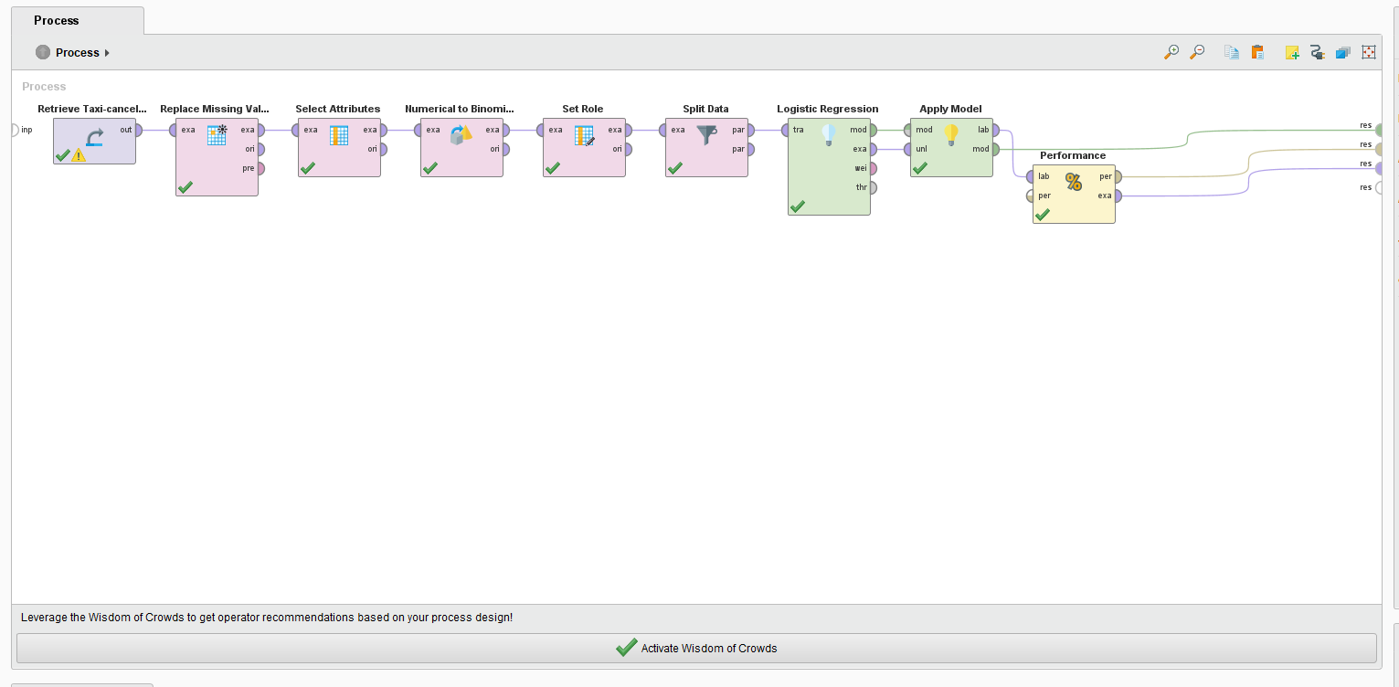
Design of Logistic Regression

Slide 6
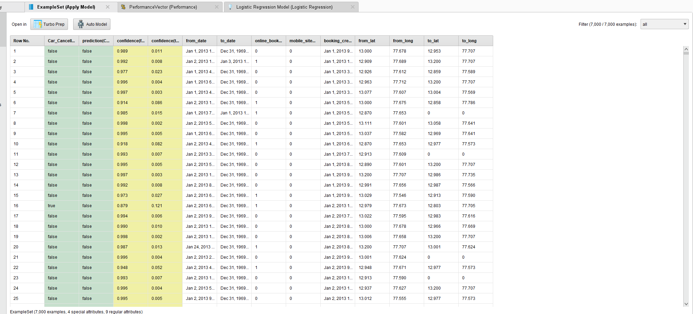
Example Set of Logistic Regression

Slide 7
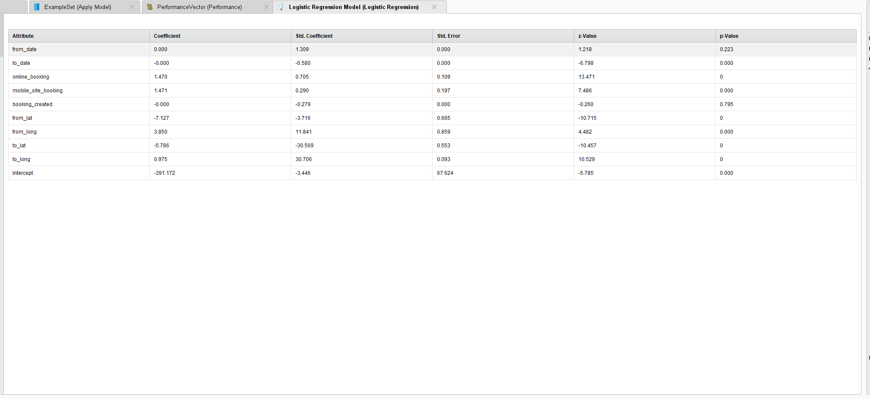
Logistic Regression

Slide 8
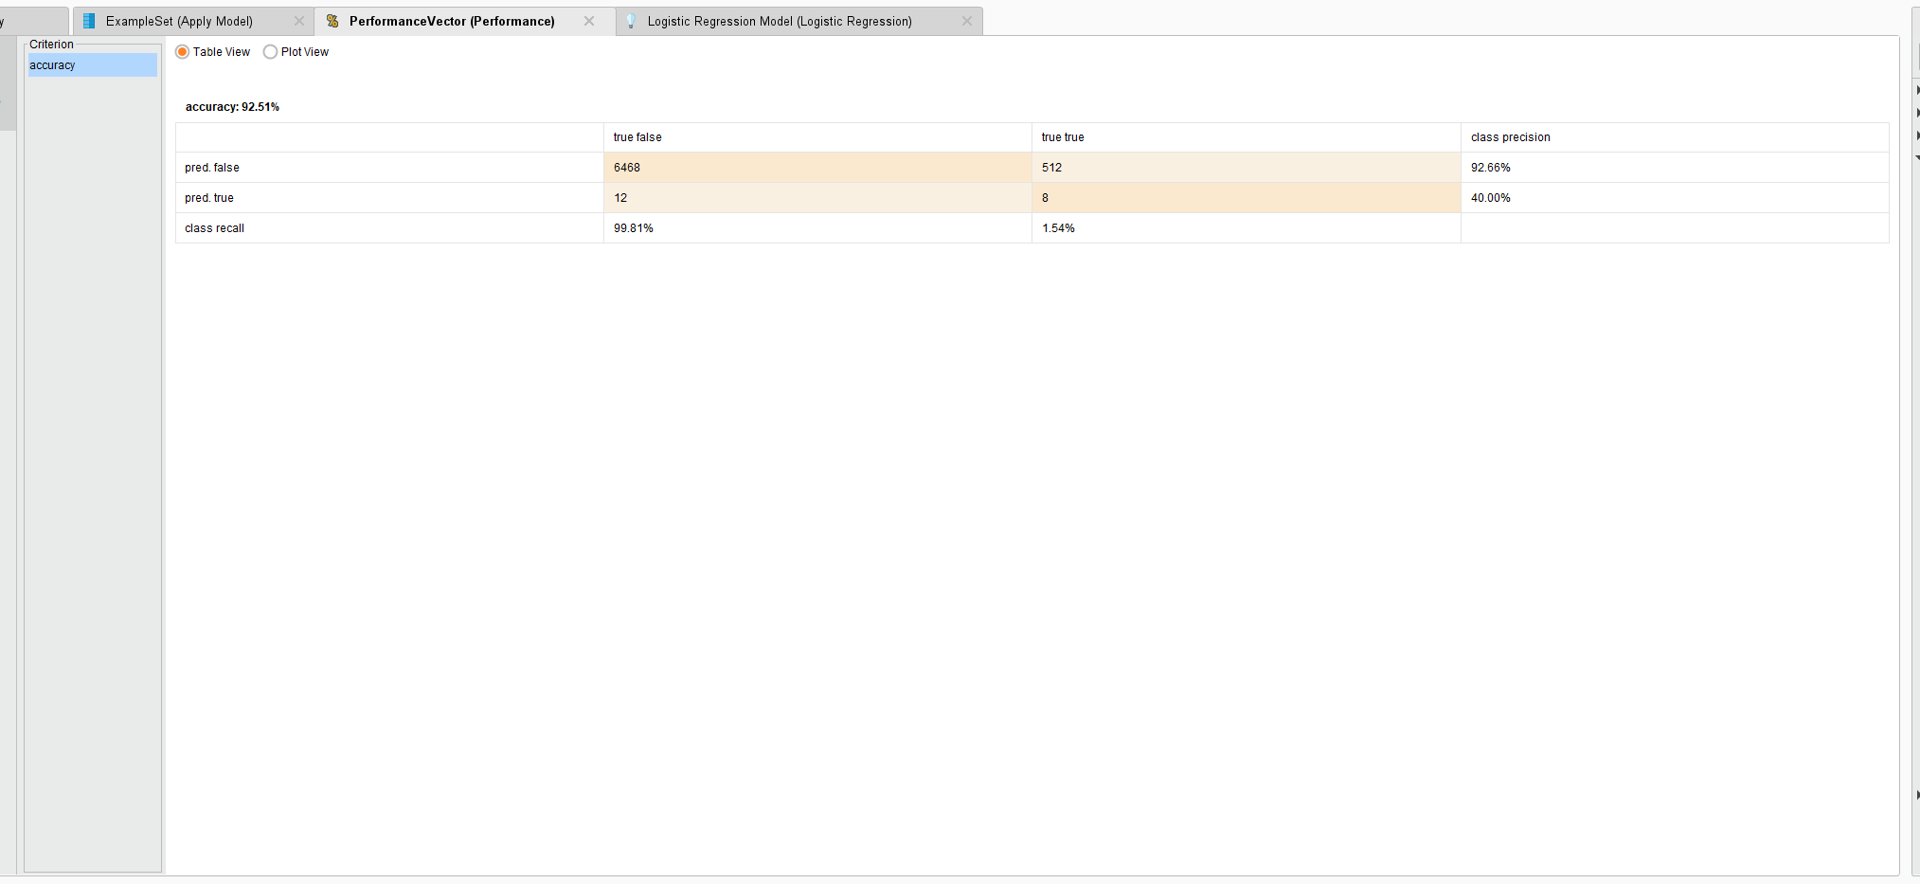
Logistic Regression Performance

Slide 9
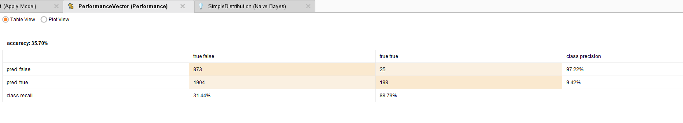
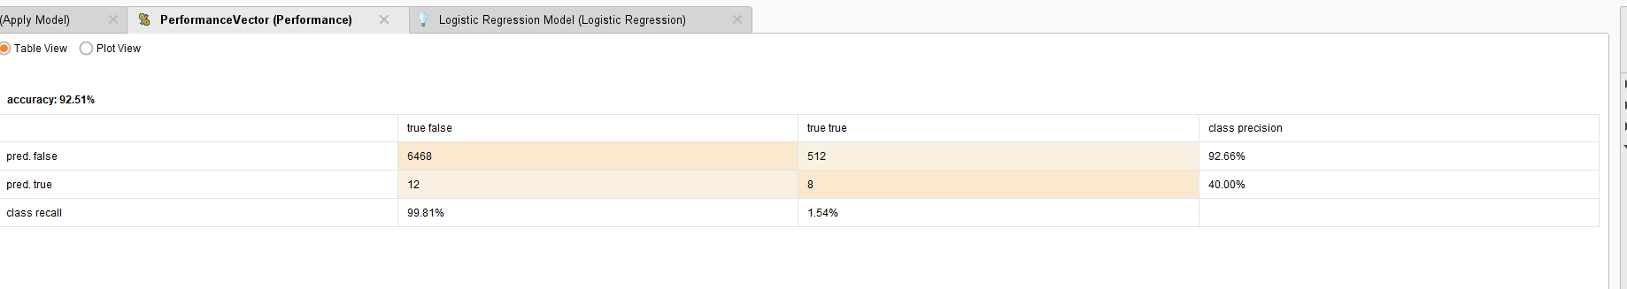
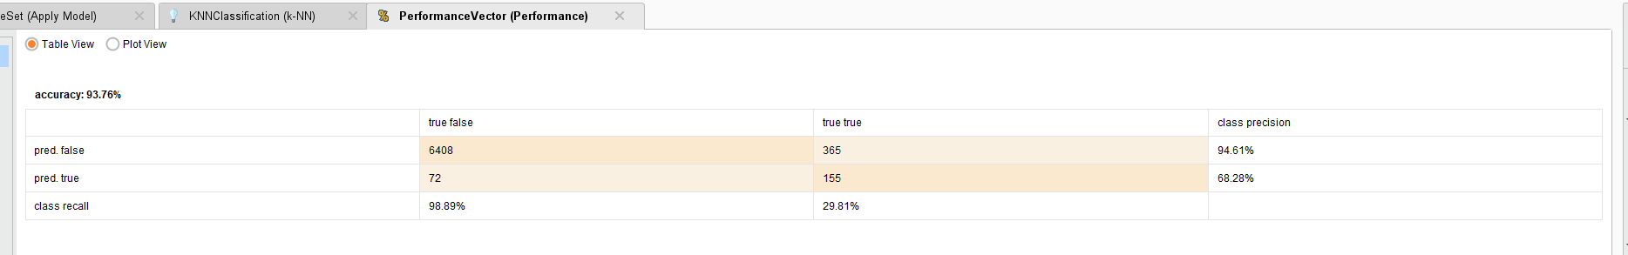
Naïve Base
Performance Comparison
Logistic Regression
KNN

Slide 10
Analyzation of Performance Comparison &
Logistic Regression Chart
The coefficient shows that shows positive influence is online booking, mobile site booking, from_long and to_long
The coefficient that’s shows negative is from_lat and to_lat
Standard Error of from_date, to_date, online_booking, mobile_site_booking, book_created, and to_long ; has a better interpretation of how accurate the mean is.
Naïve Base has the lowest accuracy of any model
Logistic Regression have the best class recall which means it has the best return ratio.
KNN the second-best accuracy in predicting false.

Slide 11
Questions and Results
How can a predictive model based on these data be used by Yourcabs.com?
Predictive models can classify whether a taxicab will be cancelled or not based on the independent variables and using these independent variables in models that can predict and classify certain outcome. I chose the predictors stated earlier because of the characteristics of the predictor variables and the ability to work in classification model.
Fit several predictive models of your choice. Do they provide information on how the predictor variables relate to cancellations?
There is one model that shows the relationship between the independent variables and variables which is logistic regression
Report the predictive performance of your model in terms of error rates (the confusion matrix). How well does the model perform? Can the model be used in practice?
The best performing model for performance is KNN with the best accuracy rate.

Slide 12
Conclusion
Logistic regression helped identified the relationship between the independent variables and the dependent variables. While KNN had the best accuracy performance in classifying whether the taxi will be canceled or not. The best predictors for determining a cancellation or not turned out to be online booking, mobile booking, and from longitude and to longitude. Also, logistic regression can show what influences the dependent variable with probability of prediction or accuracy of prediction.

Slide 13
Thank You
Bonus Slides after this one!

Slide 14
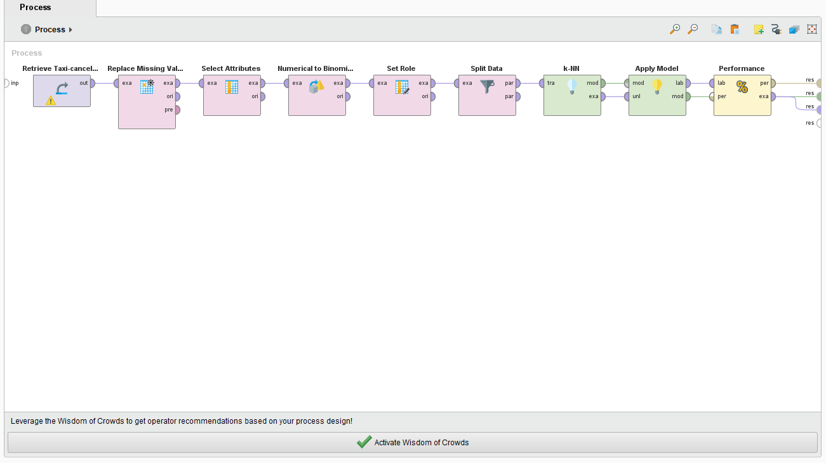
Design of KNN

Slide 15
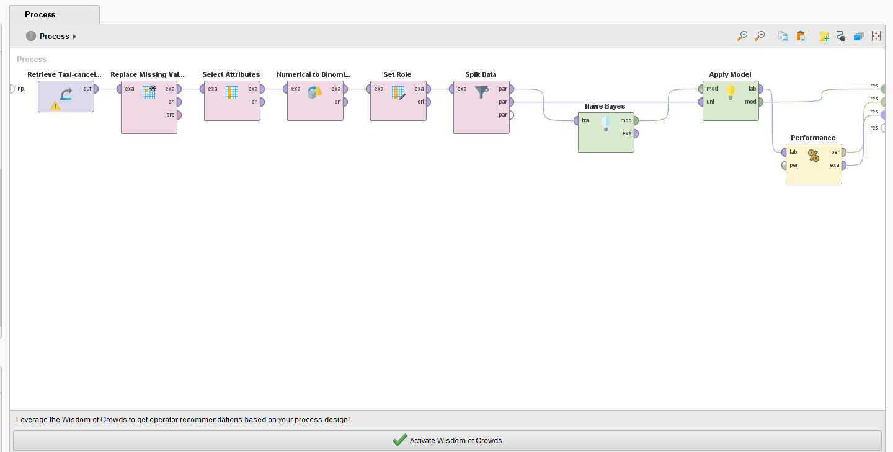
Design of Naïve Bases

Slide 16
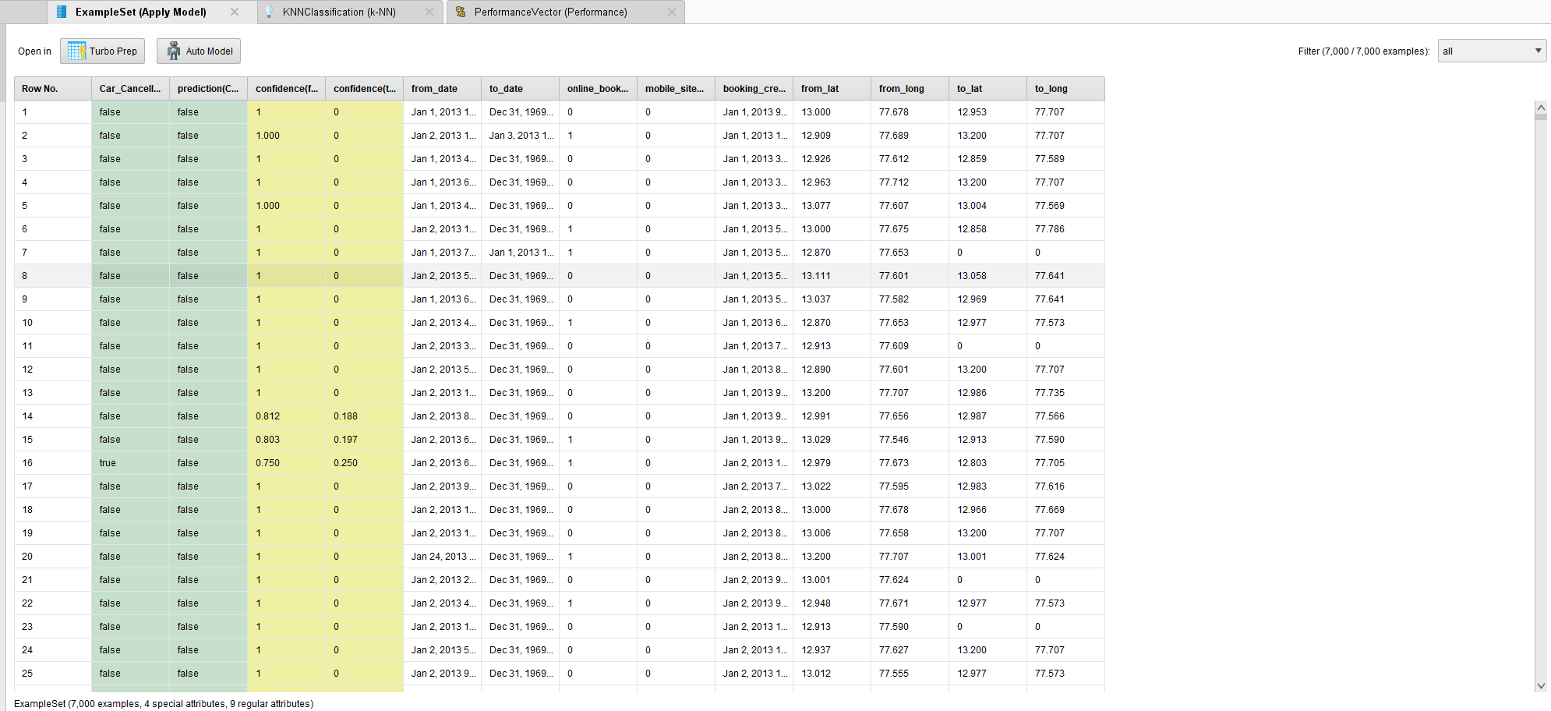
Example Set of KNN

Slide 17
Example Set of Naïve Bases

Slide 18
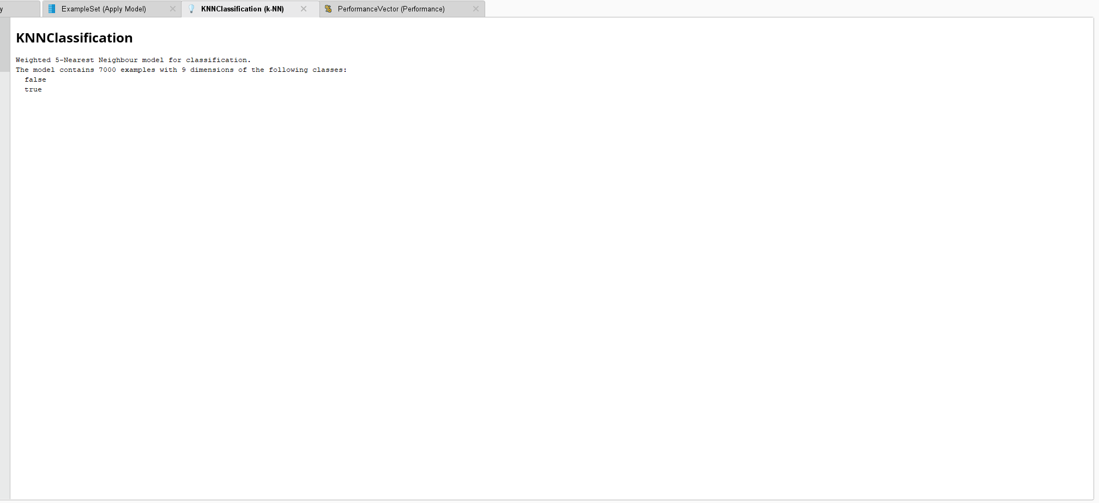
KNN Classification of KNN

Slide 19
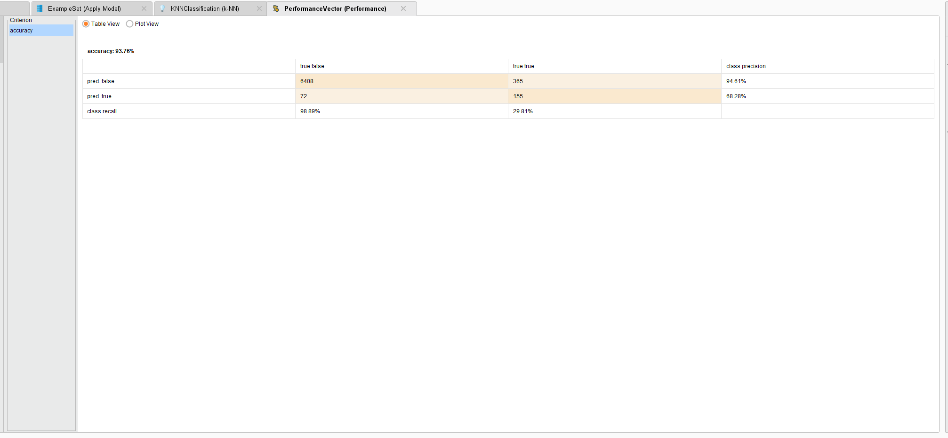
KNN Performance

Slide 20
Performance Vector Naïve Bases

